Slide 1
Challenge 5 Steering the Car
Team members:
Shisheng wang
xiangtian yi
Ye xing
Yanlin zhou

Slide 2
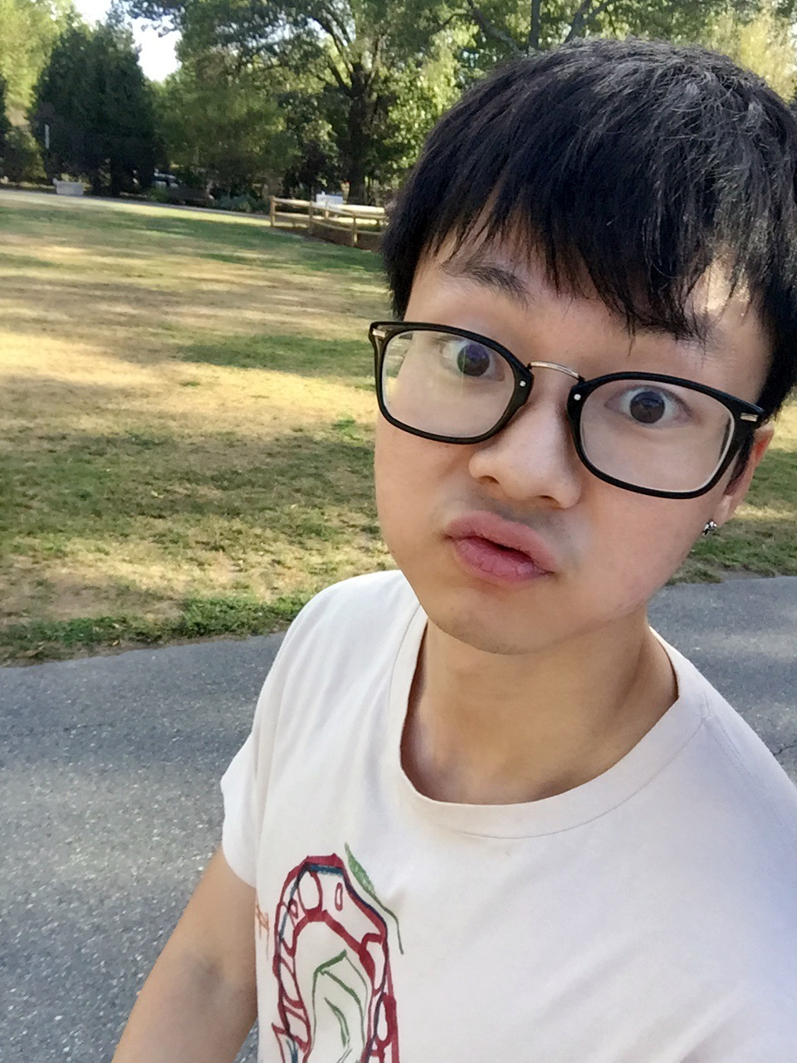
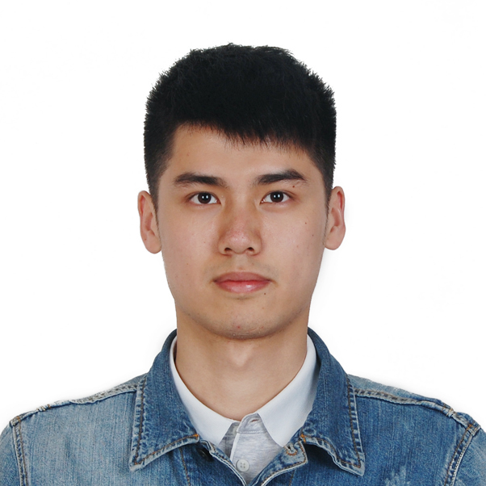
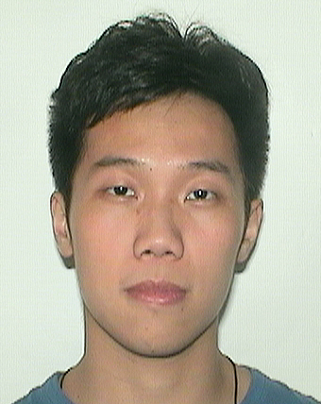
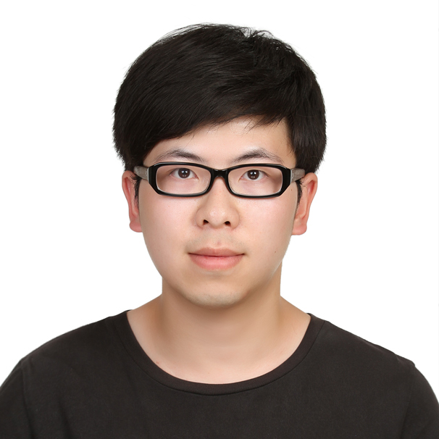
Presenter on this challenge
 | Xiangtian | Shisheng | Ye | Yanlin
Challenge 1 | Presenter
Challenge 2 |  | Presenter
Challenge 3 |  |  | Presenter
Challenge 4 |  |  |  | Presenter
Challenge 5 |  |  | Presenter
Challenge 6
Challenge 7
Challenge 8

Slide 3
TEAM WORK
Xiangtian | Shisheng | Ye | Yanlin
I helped with debugging the adjustment to steer the car accurately. And I implemented the circuit of Lidar, tested the correctness of the data received. | I assembled the wire on the board and I wrote the html and node.js of remote control on the car, help testing steering the car, and optimize the code of the arduino on the car. | I mainly designed the arduino code and assembled the wire on the board for Ultrasonic and the car. Tested and optimized the paramaters for PID control.. | In this challenge, I engaged in speed sensor test and helped testing steering the car and the LIDAR, and optimize the code of the Arduino on the car.

Slide 4
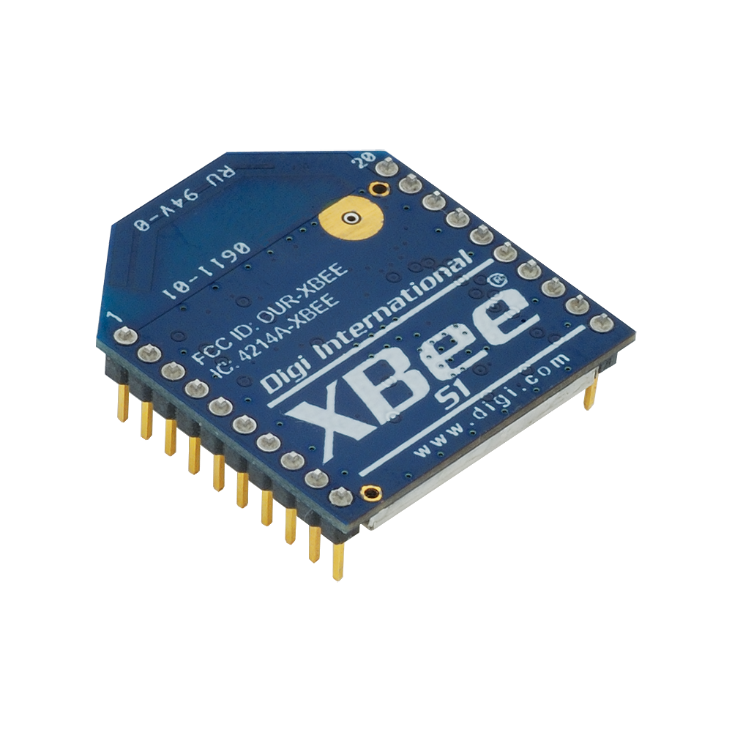


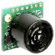
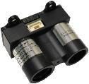
architecture
Localhost:3000

Slide 5
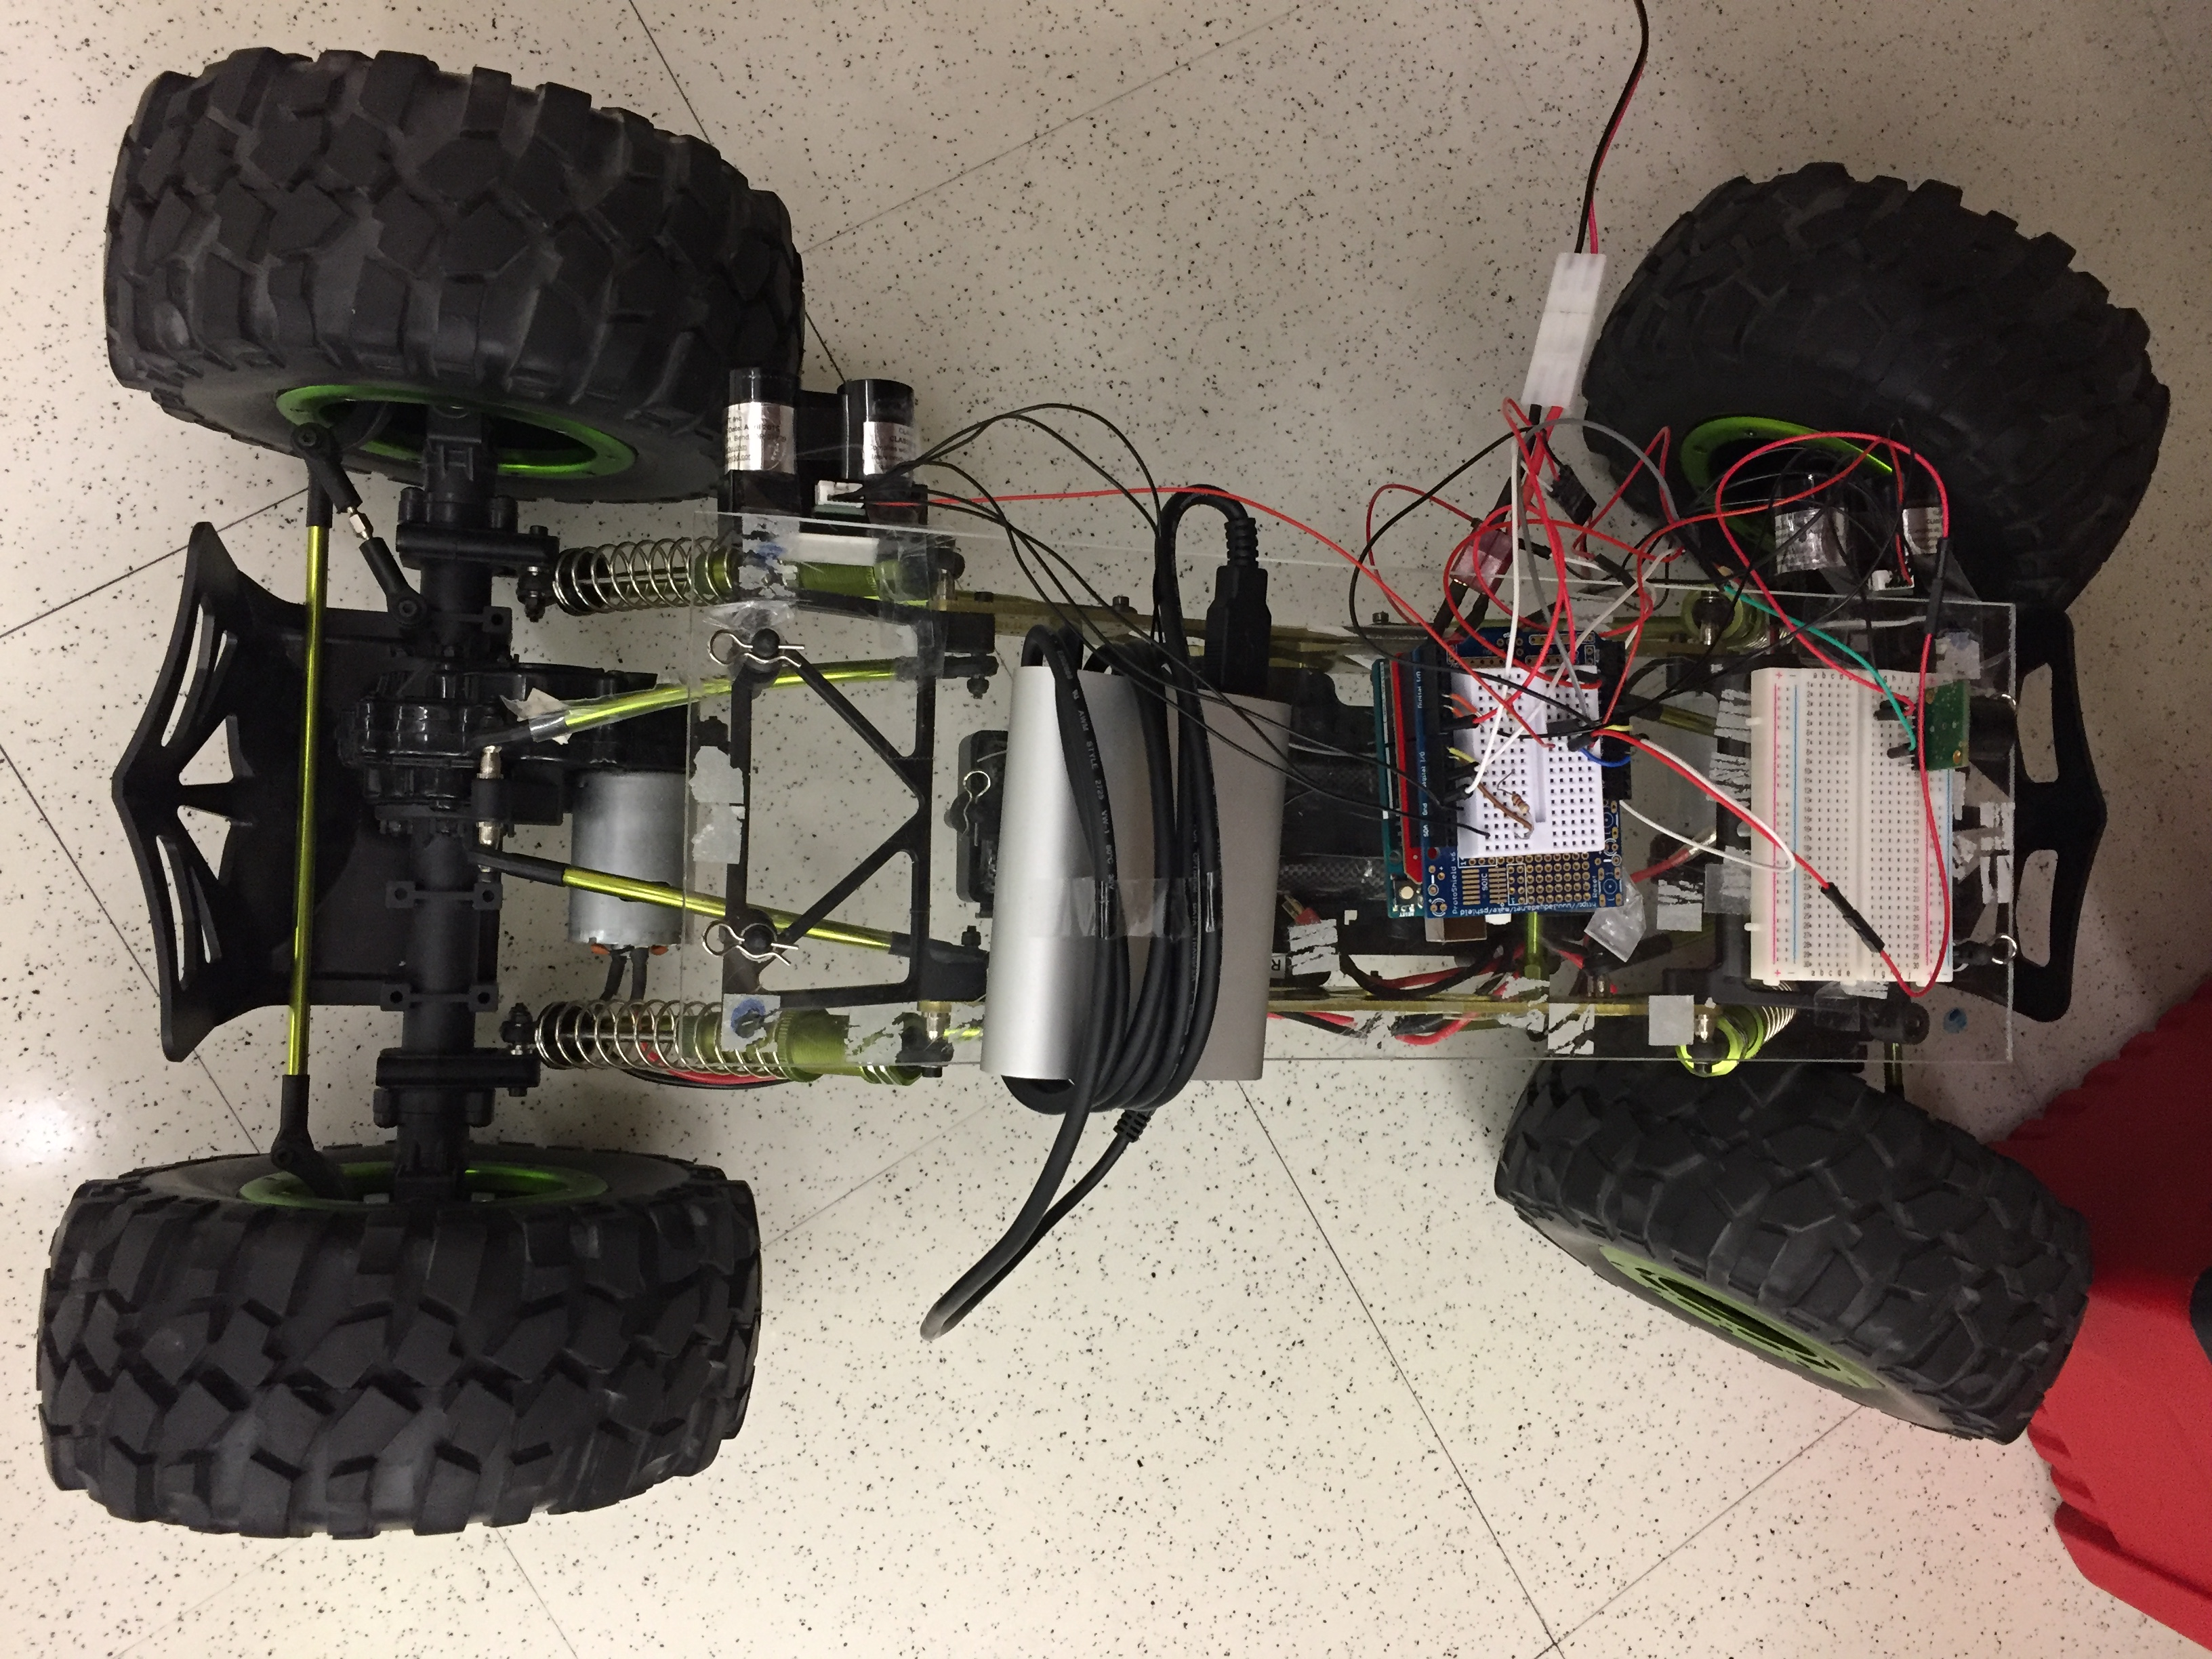
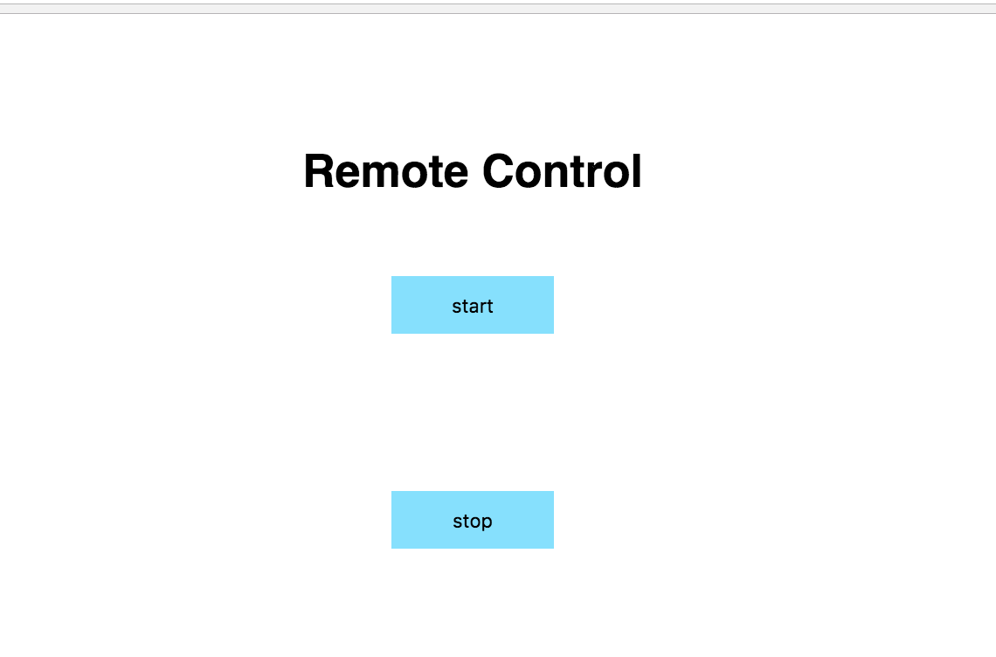
Photos of developed system

Slide 6
DESIGN DECISIONS
Sensors
2 LIDAR sensor on one side
Using the difference of the two values to control the car
Accurate measures
1 Ultrasonic sensor in the front
Effectively detecting things ahead
scalable

Slide 7
DESIGN DECISIONS
Control Algorithms
Side
PID: Distance to wall control
Adapt the output to adjust the wheel direction
Bound control
Front
Read data from the ultrasonic sensor and stop if obstacle ahead
Remote Control
Use Xbee to remote start and stop the car

Slide 8
Challenge & future improvement
Challenges:
Understanding the functionality and specifications of provided sensors and choosing the most suitable ones.
Test the PID control and find the most suitable parameter
Improvement:
Remote speed control
Reduce delay
Improve accuracy of the algorithm

Slide 9
Thank you !

